Slide 1
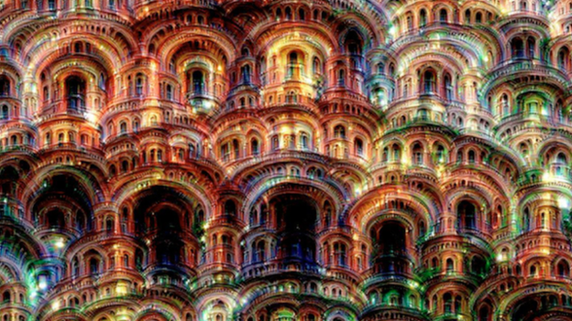




@ProlificIdea
@Entelect
ProlificIdea.com
Machine Learning – Image Classification
Notes:
Rishal presenting in Cape Town
Rushil a.k.a Russel is helping us out on the Introductory track
Line up
Presentation - Neural Network at bar area and Introductory in the board room.
Introductory track will be the same as the first presentation we gave, for those already attended can join the Neural Network talk
We will be wrapping up at around 8:30 and a quick chat about the experience

Slide 2
In The News
Google Wavenet
Microsoft speech engine improvements
Notes:
Wavenet
Google created a new AI called wavenet developed by the same deepmind team.
It can speak using sound waves generated from a convolution nueral network
Microsoft Speech Engine
The speech engine has now reached human parity, meaning they have a 5.8 percent error rate at understanding human speech.

Slide 3
Convolutional Neural Networks
Notes:
Slides/Presentation created by Brandon Rohrer
Youtube channel for more in depth explanation

Slide 4
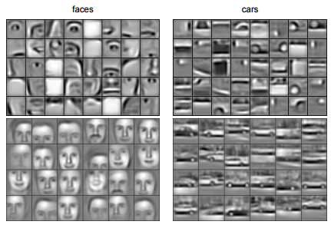
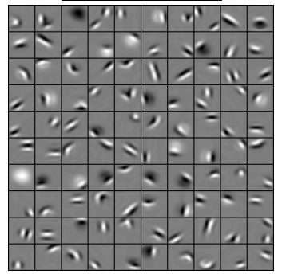
Convolutional Deep Belief Networks for Scalable Unsupervised Learning of Hierarchical Representations Honglak Lee, Roger Grosse, Rajesh Ranganath, Andrew Y. Ng
Notes:
Can do pretty cool things
Learns features like edges/dots/bright spots/dark spots automatically
Part of mutli layer network then
First layer edges etc.
Second layer eyes/ears etc
3rd layer Recognizable features like faces etc
Same applies for cars

Slide 5
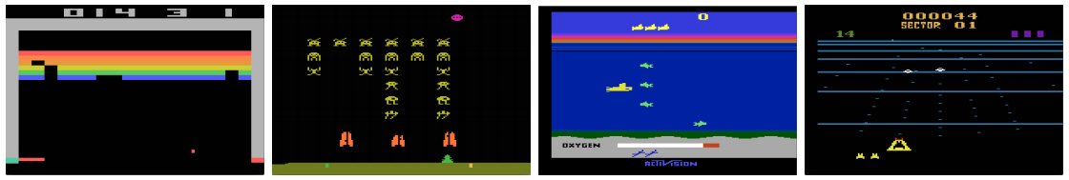
Playing Atari with Deep Reinforcement Learning. Volodymyr Mnih, Koray Kavukcuoglu, David Silver, Alex Graves, Ioannis Antonoglou, Daan Wierstra, Martin Riedmiller
Notes:
CNN’s can learn to play video games
Learns patterns from pixels on screen and take actions
Can learn to play video games

Slide 6
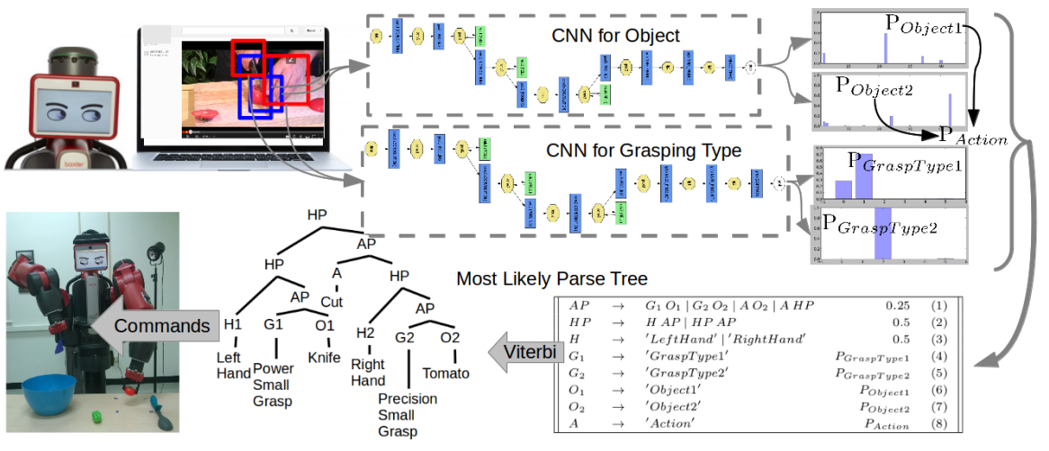
Robot Learning ManipulationAction Plans by “Watching” Unconstrained Videos from the World Wide Web. Yezhou Yang, Cornelia Fermuller, Yiannis Aloimonos
Notes:
A couple of CNN’s can be trained by watching youtube videos which can then be in turned used to control robots like learning to cook

Slide 7
A toy ConvNet: X’s and O’s
Says whether a picture is of an X or an O
A two-dimensional
array of pixels
CNN
X or O
Notes:
CNN’s are powerfull
Basic ideas applied in a powerful way
Example of a small and basic CNN
Take an image and based on the pixel values Identify either X or O in image

Slide 8
For example
CNN
X
CNN
O
Notes:
Top: Image with X in white pixels
Bottom: Image with O in white pixels

Slide 9
Trickier cases
CNN
X
translation
scaling
rotation
weight
CNN
O
Notes:
CNN goes through several steps to accomplish identification
There are some tricky cases, which CNN’s excel at
With all of the above cases we still want the correct classification

Slide 10
Deciding is hard
?
=
Notes:
For humans this is easy, we recognise patterns

Slide 11
What computers see
?
=
Notes:
Computers will try to analyse on pixel comparisons

Slide 12
What computers see
Notes:
This what a computer will see with a blind comparison

Slide 13
Computers are literal
=
x
Notes:
With just comparison the computer cannot determine what the image is

Slide 14
ConvNets match pieces of the image
=
=
=
Notes:
CNN’s work by matching parts of images, by breaking the image into sections it becomes more clear to see if the images are similar

Slide 15
Features match pieces of the image
Notes:
Examples of features (mini images)
Diagonal lines and X in features

Slide 16
Notes:
These features will match the image

Slide 21
Filtering: The math behind the match
Notes:
So we have the bits and pieces
The math behind all this is called filtering
Feature is lined up with the patch in the image

Slide 22
Filtering: The math behind the match
Line up the feature and the image patch.
Multiply each image pixel by the corresponding feature pixel.
Add them up.
Divide by the total number of pixels in the feature.
Notes:
One by one pixels are compared
Multiplied by each other
Then Added up and divided by total number of pixels

Slide 23
Filtering: The math behind the match
1 x 1 = 1
Notes:
Lets step though it to see why it makes sense to do this
Talk through slides

Slide 24
Filtering: The math behind the match
1 x 1 = 1

Slide 25
Filtering: The math behind the match
-1 x -1 = 1

Slide 26
Filtering: The math behind the match
-1 x -1 = 1

Slide 27
Filtering: The math behind the match
-1 x -1 = 1

Slide 28
Filtering: The math behind the match
1 x 1 = 1

Slide 29
Filtering: The math behind the match
-1 x -1 = 1

Slide 30
Filtering: The math behind the match
-1 x -1 = 1

Slide 31
Filtering: The math behind the match
-1 x -1 = 1

Slide 32
Filtering: The math behind the match
1 x 1 = 1
Notes:
Because the pixels are always the same the all add up to one

Slide 33

Filtering: The math behind the match
$$\frac{1+1+1+1+1+1+1+1+1}{9}=1$$
Notes:
So lets count all of them together and divide by 9 (9 pixels) and we get an answer of one
No we want to keep track of where the image was and put a one there
This allows us to say when we get a feature there we get a result of one
That is filtering

Slide 34
Filtering: The math behind the match
1 x 1 = 1
Notes:
Lets see an example of same feature on a different part of the image
Talk through slides

Slide 35
Filtering: The math behind the match
-1 x 1 = -1
Notes:
No we get a part of the feature that does not match, and put a -1

Slide 36
Filtering: The math behind the match
Notes:
Continue going though all the pixels until they have all been calculated

Slide 37

Filtering: The math behind the match
$$\frac{1+1−1+1+1+1−1+1+1}{9}=.55$$
.55
Notes:
No we get a result of .55 and record it
So by moving our filter around the image to different places we get values that indicate how well that feature is represented in that part of the image
This becomes a map of where the feature occurs

Slide 38
Convolution: Trying every possible match
Notes:
By moving the feature around to ever possible position in the image we do convolution, that is the repeated application of that feature (filter) over and over again. And what we get is a nice map across the whole image of where the feature occurs. If we look at it we see the parts where the feature clearly matches part of the image from the high numbers in the filtered image.

Slide 39
Convolution: Trying every possible match
=
Notes:
Circle with X represents a convolution of that feature

Slide 40
=
=
=
Notes:
This is what our filtered convolutions look like with the different features we identified.
The maps we get is consistent with where we expect those features to be.

Slide 41
Convolution layer
One image becomes a stack of filtered images
Notes:
A convolution layer is this act of building a stack of filtered images with the different features.
A layer (because it is an operation) that we can stack with others.

Slide 42
Convolution layer
One image becomes a stack of filtered images
Notes:
In convolution one image becomes a stack of filtered images. We can get as many filtered images as we have filters.

Slide 43
Pooling: Shrinking the image stack
Pick a window size (usually 2 or 3).
Pick a stride (usually 2).
Walk your window across your filtered images.
From each window, take the maximum value.
Notes:
Convolution layer is one trick we have.
Another feature we have is called pooling and it very basic, it basically shrinks the image step.
Talk through steps.

Slide 44
Pooling
maximum
Notes:
Pooling on filtered image.
Take max value and put it in a new map.
Talk through slides.

Slide 45
Pooling
maximum

Slide 46
Pooling
maximum

Slide 47
Pooling
maximum
Notes:
Here we have to be creative, don’t have all the pixels so we take the max of what is available.

Slide 48
Pooling
maximum

Slide 49
Pooling
max pooling
Notes:
We end up a similar pattern, but smaller filtered image. You can see that the important features are still there with the high values on the diagonal. This halved our image and essentially helps us with processing. The other big help is pooling makes this less sensitive to where in the image this feature is, it can be a little to the left/right and still give a high max value in the pooled image.

Slide 50
Notes:
We do max pooling with all our stacked filtered images

Slide 51
Pooling layer
A stack of images becomes a stack of smaller images.
Notes:
And end up with a smaller stack of filtered images

Slide 52
Normalization
Keep the math from breaking by tweaking each of the values just a bit.
Change everything negative to zero.
Notes:
3rd trick – Normalization, Prevent the math from blowing up
All you do is everywhere there is a negative value, change it to zero

Slide 53
Rectified Linear Units (ReLUs)
Notes:
Rectified Linear Units, these are the bits that do this for us. They just step through every result (pixel) in the filtered image and changes negative values to 0.

Slide 54
Rectified Linear Units (ReLUs)

Slide 55
Rectified Linear Units (ReLUs)

Slide 56
Rectified Linear Units (ReLUs)

Slide 57
ReLU layer
A stack of images becomes a stack of images with no negative values.
Notes:
So we end up with a ReLu layer that changes a stack of filtered images in to a stack of filtered images with no negative values

Slide 58
Layers get stacked
The output of one becomes the input of the next.
Convolution
ReLU
Pooling
Notes:
This is where the magic starts to happen. Now we stack the layers, and the output of one layer becomes the input of the next, the inputs and outputs are basically and array of an array of pixels. By stacking them these operations build on top of each other.

Slide 59
Deep stacking
Layers can be repeated several (or many) times.
Convolution
ReLU
Convolution
ReLU
Pooling
Convolution
ReLU
Pooling
Notes:
You can stack as many of these together as you want to make a deep stack, each of these layers transform the image a little, with the pooling layers making it smaller at every step.

Slide 60
Fully connected layer
Every value gets a vote
Notes:
Our final layer is the fully connected layer, here every value gets a “vote”. We take the result of our layer stack, the filtered and reduced images, and break out each of the values and put them into a single list because it is easier to visualize.

Slide 61
Fully connected layer
Vote depends on how strongly a value predicts X or O
X
O
Notes:
Each of those connects to one of our answers. Some of the values will predict strongly for an X, those values get a stronger vote (weight) for and X.

Slide 62
Fully connected layer
Vote depends on how strongly a value predicts X or O
X
O
Notes:
Same for when we match an O

Slide 63
Fully connected layer
Future values vote on X or O
X
O
Notes:
When we get a new input and don’t know what it is, our input goes through all of our convolutional layers and at the end we get the same single list.

Slide 64
Fully connected layer
Future values vote on X or O
X
O
Notes:
Based on our previous voting weights we can now determine the average vote for each classification

Slide 65
Fully connected layer
Future values vote on X or O
X
.92
O
Notes:
Here we can see this particular input voted for X with 92%

Slide 66
Fully connected layer
Future values vote on X or O
X
.92
O

Slide 67
Fully connected layer
Future values vote on X or O
X
.92
O
.51
Notes:
And O with 51%

Slide 68
Fully connected layer
Future values vote on X or O
X
.92
O
.51
Notes:
So X is the clear winner here

Slide 69
Fully connected layer
A list of feature values becomes a list of votes.
X
O
Notes:
In a fully connected layer a list of feature values becomes a list of votes

Slide 70
Fully connected layer
These can also be stacked.
X
O
Notes:
This can also be stacked into multiple layers. So for those that have noticed this already, the fully connected layer is basically a neural network that runs based on the feature results from our convolutional layer stacks.

Slide 71
Putting it all together
A set of pixels becomes a set of votes.
.92
X
Convolution
ReLU
Fully
connected
Fully
connected
Convolution
ReLU
Convolution
ReLU
Pooling
Pooling
O
.51
Notes:
So an input image, a set of pixels, becomes a list or votes that give us a prediction at the end

Slide 72
Learning
Q: Where do all the magic numbers come from?
Features in convolutional layers
Voting weights in fully connected layers
A: Backpropagation
Notes:
All of the numbers and values are learned by using backpropagation, so lets recap on that a bit

Slide 73
Backprop
Error = right answer – actual answer
.92
X
Convolution
ReLU
Fully
connected
Fully
connected
Convolution
ReLU
Convolution
ReLU
Pooling
Pooling
O
.51
Notes:
Backpropagation is method to teach and train the network based on the error of the prediction

Slide 74
Backprop
.92
X
Convolution
ReLU
Fully
connected
Fully
connected
Convolution
ReLU
Convolution
ReLU
Pooling
Pooling
O
.51
Notes:
For example, lets say we expected a prediction of 1

Slide 75
Backprop
.92
X
Convolution
ReLU
Fully
connected
Fully
connected
Convolution
ReLU
Convolution
ReLU
Pooling
Pooling
O
.51
Notes:
And the actual answer from the network was .92

Slide 76
Backprop
.92
X
Convolution
ReLU
Fully
connected
Fully
connected
Convolution
ReLU
Convolution
ReLU
Pooling
Pooling
O
.51
Notes:
We know we have an error of .08

Slide 77
Backprop
.92
X
Convolution
ReLU
Fully
connected
Fully
connected
Convolution
ReLU
Convolution
ReLU
Pooling
Pooling
O
.51
Notes:
And an error of .49 for )

Slide 78
Backprop
.92
X
Convolution
ReLU
Fully
connected
Fully
connected
Convolution
ReLU
Convolution
ReLU
Pooling
Pooling
O
.51
Notes:
So if we add that up we get a total error of 0.57

Slide 79
Gradient descent
For each feature pixel and voting weight, adjust it up and down a bit and see how the error changes.
error
weight
Notes:
What happens with the error signal is it drives a process called gradient descent. It works by adjusting the weights up and down a bit to see how the error changes. The error determines how big the adjustment will be.

Slide 80
Gradient descent
For each feature pixel and voting weight, adjust it up and down a bit and see how the error changes.
error
weight
Notes:
What you want to do is get the error to the very bottom of the gradient, if you are already close to the bottom not a lot of changes has to happen.

Slide 81
Hyperparameters (knobs)
Convolution
Number of features
Size of features
Pooling
Window size
Window stride
Fully Connected
Number of neurons
Notes:
Doing the back propagation training will adjust all of these features and weights for you, they are learned automatically through training.
So the only things you have to change and tweak in a CNN is the hyper parameters (or little knobs you can turn).
These are the amount of features and their size, the pooling windows size and stride and the amount of neurons in the fully connected layer. You should play around with these to find the one that works well for your classification task.

Slide 82
Architecture
How many of each type of layer?
In what order?
Notes:
Other decisions are for instance how type of each layer, and in what order? Or maybe creating new types of layers etc. This is where the big developments in CNN’s is happening all around the world.

Slide 83
Not just images
Any 2D (or 3D) data.
Things closer together are more closely related than things far away.
Notes:
CNN’s can process any 2D or 3D data where data can be spatially related. They are not limited to images. What is important is that things closer together is more closely related than things far away.

Slide 84
Images
Columns of pixels
Rows of pixels
Notes:
For instance if you look at an image, two rows or columns that are right next to each other are more closely related than rows and columns that are far away.

Slide 85
Sound
Time steps
Intensity in each
frequency band
Notes:
Sound for instance can be represented in 2D. You can split your sound into frequency bands and time. Doing this you can see your sound now almost looks like an image, so that means you can use CNN’s on sound. This is close to what google’s wavenet is doing.

Slide 86
Text
Position in
sentence
Words in
dictionary
Notes:
You can do something similar with text. There are a few people that are playing with this with varying levels of success.

Slide 87
Limitations
ConvNets only capture local “spatial” patterns in data.
If the data can’t be made to look like an image, ConvNets are less useful.
Notes:
Convolutional Neural Networks detect patterns local spatial patterns, spatial being things that are close to each other. If you cannot make your data look like an image, you are out of luck. For example

Slide 88
Customer data
Name, age,
address, email,
purchases,
browsing activity,…
Customers
Notes:
You can not make customer data look like an image. You can rearrange the columns and rows and this will still mean the same thing, if you take a picture and do that will lose what it represented.

Slide 89
Rule of thumb
If your data is just as useful after swapping any of your columns with each other, then you can’t use Convolutional Neural Networks.

Slide 90
In a nutshell
ConvNets are great at finding patterns and using them to classify images.

Slide 91
Some ConvNet/DNN toolkits
Caffe (Berkeley Vision and Learning Center)
CNTK (Microsoft)
Deeplearning4j (Skymind)
TensorFlow (Google)
Theano (University of Montreal + broad community)
Torch (Ronan Collobert)
Many others

